Slide 1
Team 4: Nicholas Dumford, Bobby Fechtel, Chase Smith
Advisor: Dr. Shane Halse

Slide 2
The Problem
Cell phones are distracting and constantly begging for attention
Social media apps are especially addicting, designed to keep you on them as long as possible
Current solutions are primarily designed for parents

Slide 3
Our Solution
Flexible App Limits
Set daily limits, per-session timers, or both
Prevents Habituation
Thoughtful deterrence tasks prevent mindlessly opening addictive apps
Track Progress
Streaks for staying within set app limits provide positive reinforcement

Slide 4

Technical Details

Slide 5
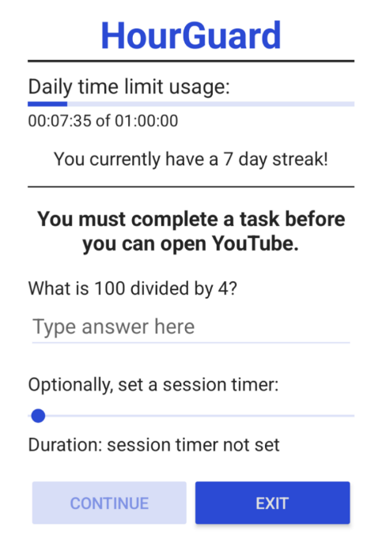
Demo

Slide 6
Conclusion
HourGuard is a psychology-backed time management app for Android devices
Helps the user build healthy screen time habits
Designed for self-regulation

